Slide 1
To-Do App
Full Stack Implementation using .NET and React

Slide 2
Project Scope & Objectives
Core Features:
User Authentication (Login/Register).
Task Management (Create, Read, Update, Delete).
Persistent Data Storage.
Approach: Decoupled architecture separating Frontend and Backend.

Slide 3
Architecture & Tech Stack
Backend
Framework: .NET 10 (C#)
ORM: Entity Framework Core
Database: SQLite (Local DB)
Auth: JWT + BCrypt
Frontend
Library: React (Vite)
Language: TypeScript
Styling: Tailwind CSS
HTTP Client: Axios

Slide 4
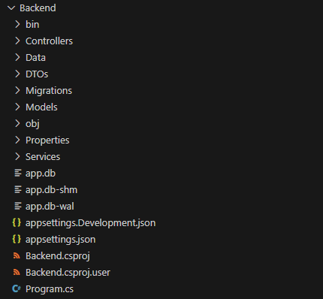
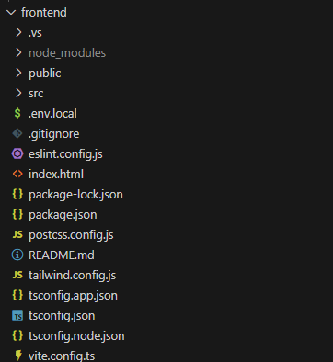

Slide 5
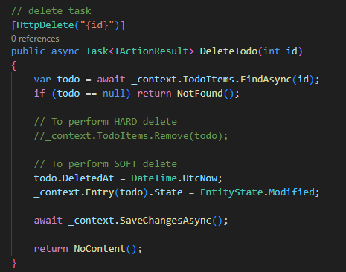
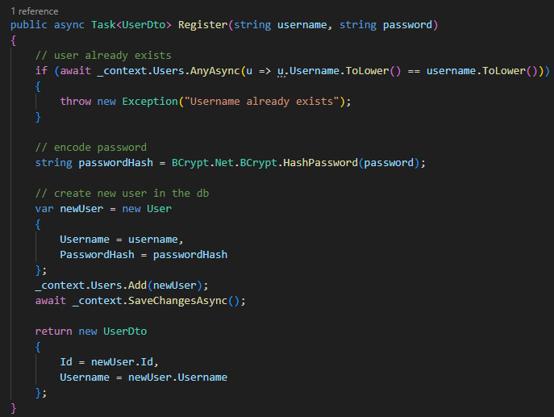
Security & "Extra Mile" Features
Implemented a Real Authentication and register System.
Password Hashing: Used BCrypt to hash passwords.
Soft Delete in DB: Never completely delete data from tables

Slide 6
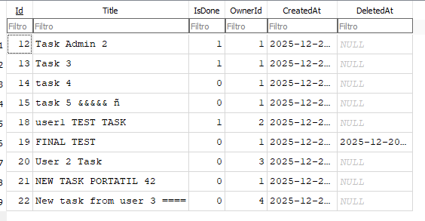
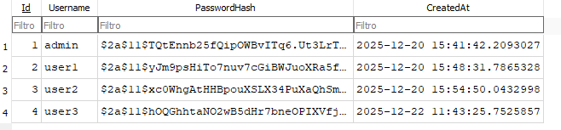
Data Model (Entity Framework)
Users Table: Stores Id, Username, and secure PasswordHash.
Todos Table: Stores Title, IsCompleted, CreatedAt.
Relationship: One-to-Many (User -> TodoItems).
Note: Each user can only access their own data via Foreign Keys.

Slide 7
Live Demo

Slide 8
Future features
Roles in Users table: To allow enable/disable certain future functionalities
Audit Fields in all tables: To help track any change
Select all button: To mark all tasks as done
Delete completed button: To delete all completed tasks

